Slide 2
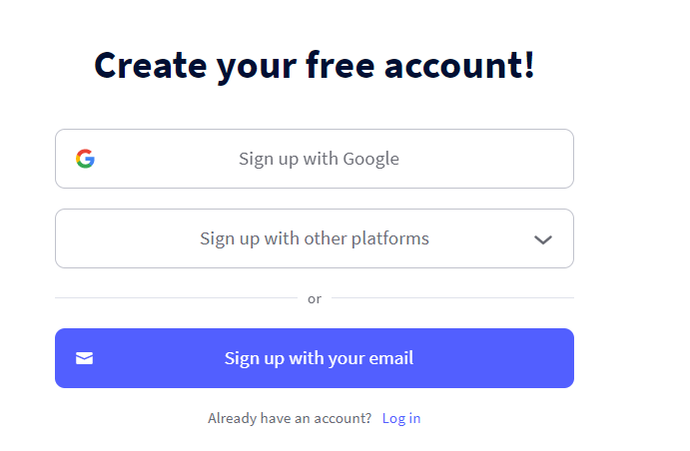
In your browser go to app.genial.ly

Slide 4
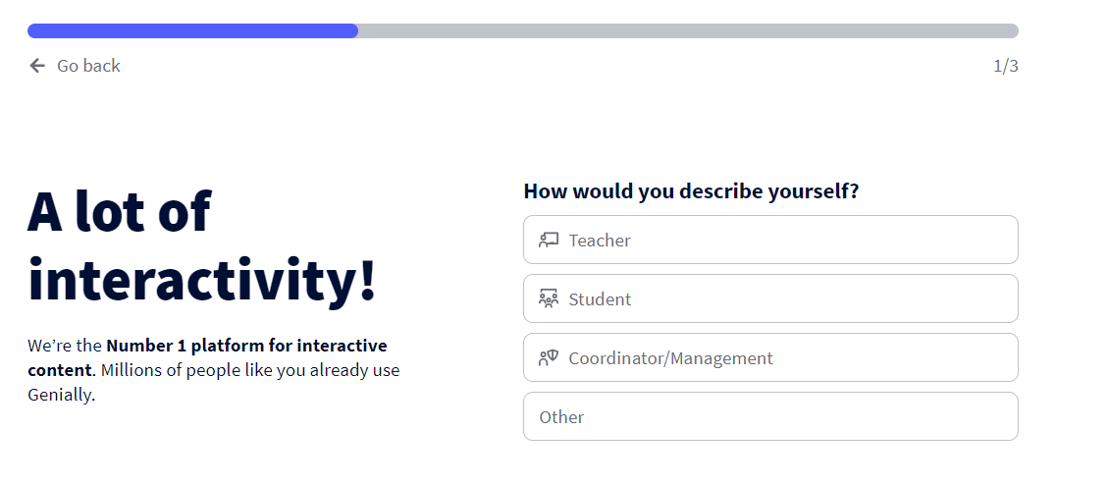
When you choose education:

Slide 5
When you choose Corporate:

Slide 6
Choose what you need

Slide 8
If you like to colaborate with your collegues you can enter your company here. You can also skip….

Slide 10
There’s a lot templates to use. The ones with the stars are premium (to pay)

Slide 11
When you have chosen a template you can change the color if you like

Slide 12
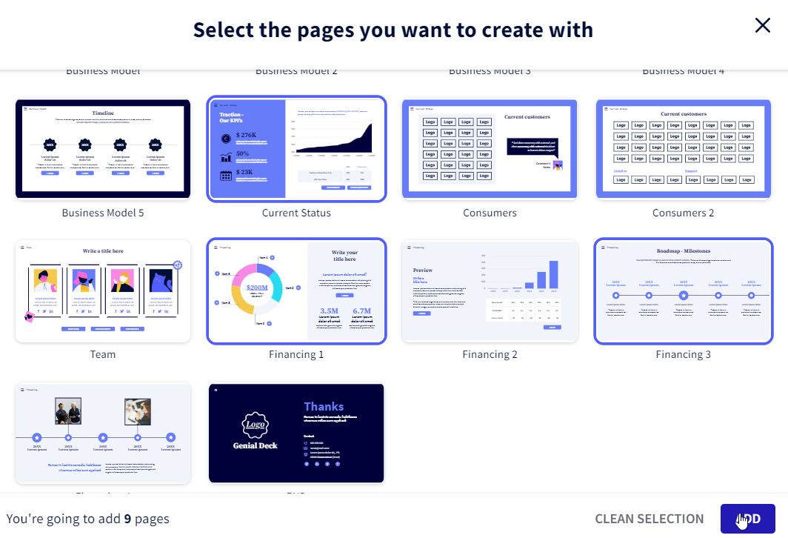

Slide 13
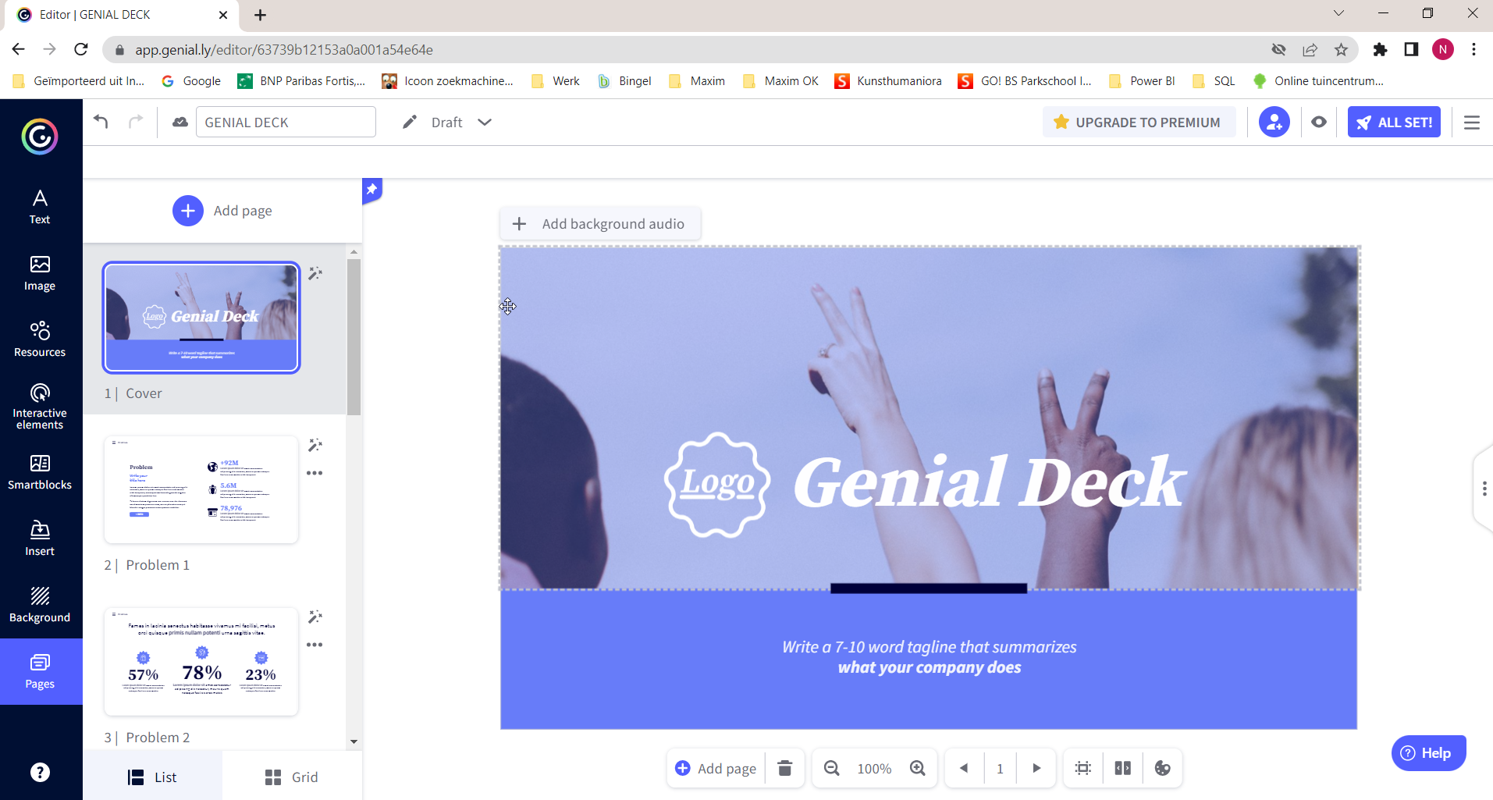
You can customise the templates as you like
Before
After

Slide 14
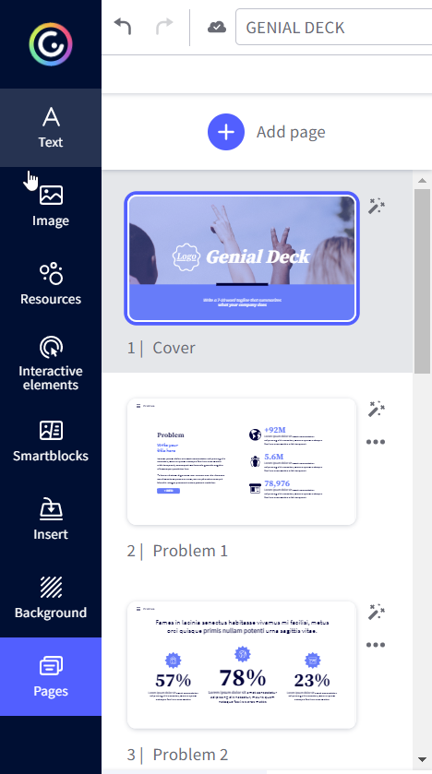
With the sidebar you can change text, add interactivity, images, etc…
When finished you push this button:

Slide 15
Now everybody can see your work, if you want it to be private you need the premium version.
You also can choose for other people to be able to use your work as a template.
You can choose a title and description but it’s not mandatory.
All Set to finish!

Slide 17
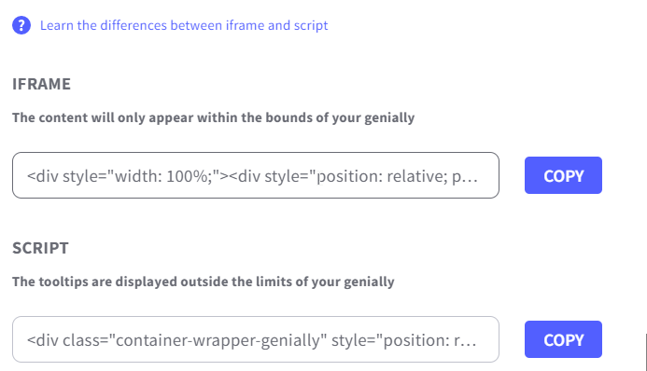
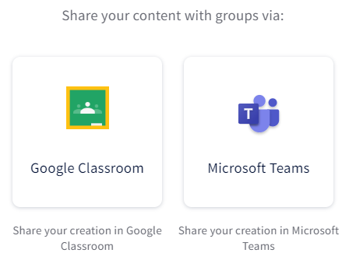
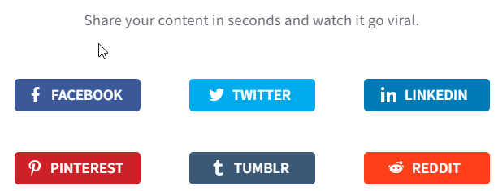
You can share the web page in 5 ways:

Slide 18
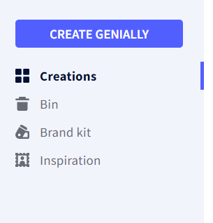
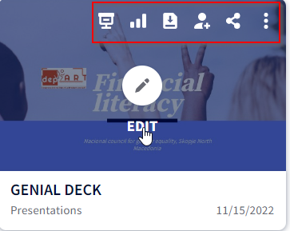
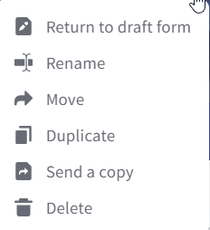
Go Back to the website:
Create Genially means a new creation
Creations = a list of your own creations
Presentation
Statistics
Download(only premium)
Collaborators
Share
Options

Slide 19
Tutorials to find if you want to learn more about it:
https://academy.genial.ly/catalogo

